Slide 1
3/6 CED Budget Analysis Update

Slide 2
User Story #1 - Budget Underutilization (Bella)
Updates: Tabulated data for missing years from Budget PDFs
Next Steps: Upload data to BigQuery to begin analysis and SQL queries
Blockers: None for now
Questions:
How many years of data to look at? Past 3 years? Past 5 Years?
Do we have data for 2023 actual expenses or has this not been published yet?

Slide 3
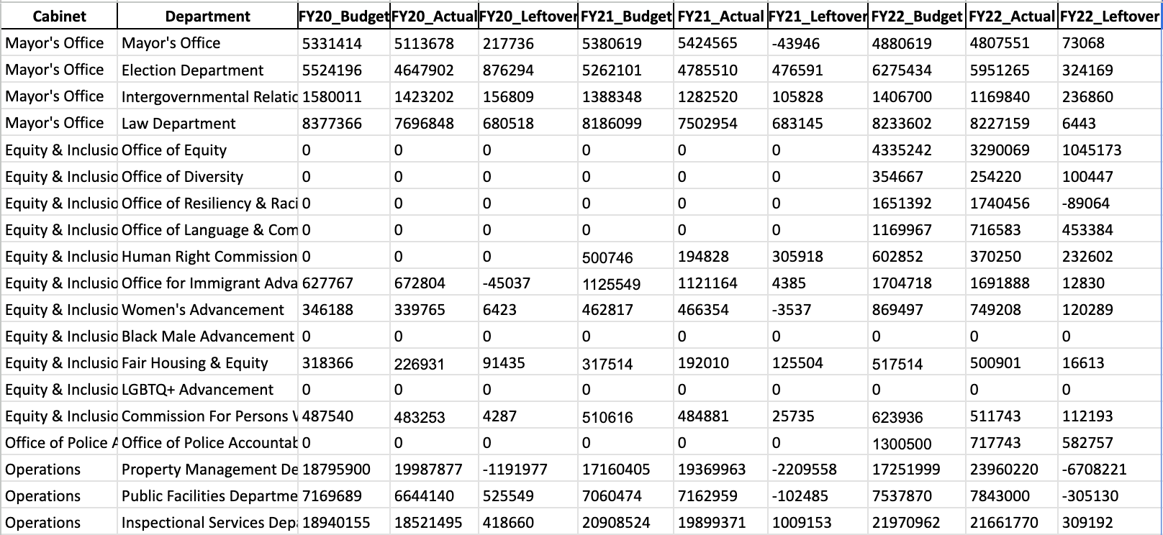
Combined Budget Dataset
All Years Budget Dataset consists of 2020, 2021, 2022 data for budget, expenses, and leftover.

Slide 4
User Story #2 - Show how much money has been coming into BPD from grants
Blockers:
The new datasets provided don’t address the user story
No data on where the money is coming from
Questions:
https://policefundingdatabase.org/explore-the-database/locations/massachusetts/boston/grant-funding

Slide 5
User Story #3- BPD to other departments (Xiao)
How much money has been moved from BPD to other departments (in FY23 there was quite a bit).
Blockers:
- Can not determine which the department the BPD spent on
Questions:
- How to determine how much money BPD spent on the specific department? Through program or expense category?
- How to deal with that missing data?

Slide 6
User Story #4: Money Saved From Overtime (Sahir)
Updates:
Now have access to all the raw data from the new spreadsheets
Next Steps:
Extracting the specific information related to # of overtime hours and total $ spent on overtime from each spreadsheet, followed by aggregation and data cleaning (removing repeated information, formatting information in easily-understandable method such as a basic table)
Blockers:
N/A
Questions:
N/A

